Slide 1
CS 4530: Fundamentals of Software Engineering Lesson 6.1 UI Design / User-Centered Design
Jonathan Bell, Adeel Bhutta, Ferdinand Vesely, Mitch Wand
Khoury College of Computer Sciences
© 2021 Released under the CC BY-SA license
Notes:
In this lesson, we will answer these questions, What does it mean for software to be usable? How can we tell if are building a usable product?

Slide 2
Learning Objectives for this Lesson
By the end of this lesson, you should be able to:
Describe the major aspects of usability;
Articulate the process of user-centered design;
Explain several heuristics for good user interaction.
Notes:
<read slide>

Slide 3
Goal: Build the Right Product
If the product doesn’t do what the users want…
… we’ve wasted time and money.
If the product is not usable by the users…
… we will need to invest time/money to make it usable.
Users are often not sure exactly what they want,
… so we iterate the requirements process.
We shift development “to the left” (closer to user)
We correct mistakes
Before design, or else
Before coding, or else
Before debugging, or else
Before deployment.
The earlier,
The better!
Notes:
When building software remember that our ultimate goal is to build the right product. If the product doesn't do what the users want or doesn't have the features requested then we've wasted time and money and user wont be happy. On the other hand, it has all the features but if the product is not usable by the users, we will need to invest more time and money to make it usable. An added difficulty in this stage is the fact that users are often not sure exactly what it is that they want. So that is why we often iterate the requirements process and continuously communicate with the customer. In agile world, we think of customer as “member” of the development team (or close to it). The idea is to help us find errors as early as possible. It really help in making product successful.

Slide 4
UI Design is important part of the link between user and technology
Software Design includes a lot more than just designing components and architecture
Important to design:
User Interfaces
Contents
Navigation
We want “Usable” software
Notes:
As a developer your job is bridge the two worlds … user’s world and technology’s. We have previously talked about three levels of design: Architecture, Interaction and Objects and we have talked about things like user stories, tasks, classes, collaborators, etc. Some of these are often related to your “backend”. There are few other important aspects of overall design that we should highlight. These are: design of user interfaces, content and navigation. This is part of “front-end” that we often work with. These are instrumental to make the system ”usable”

Slide 5
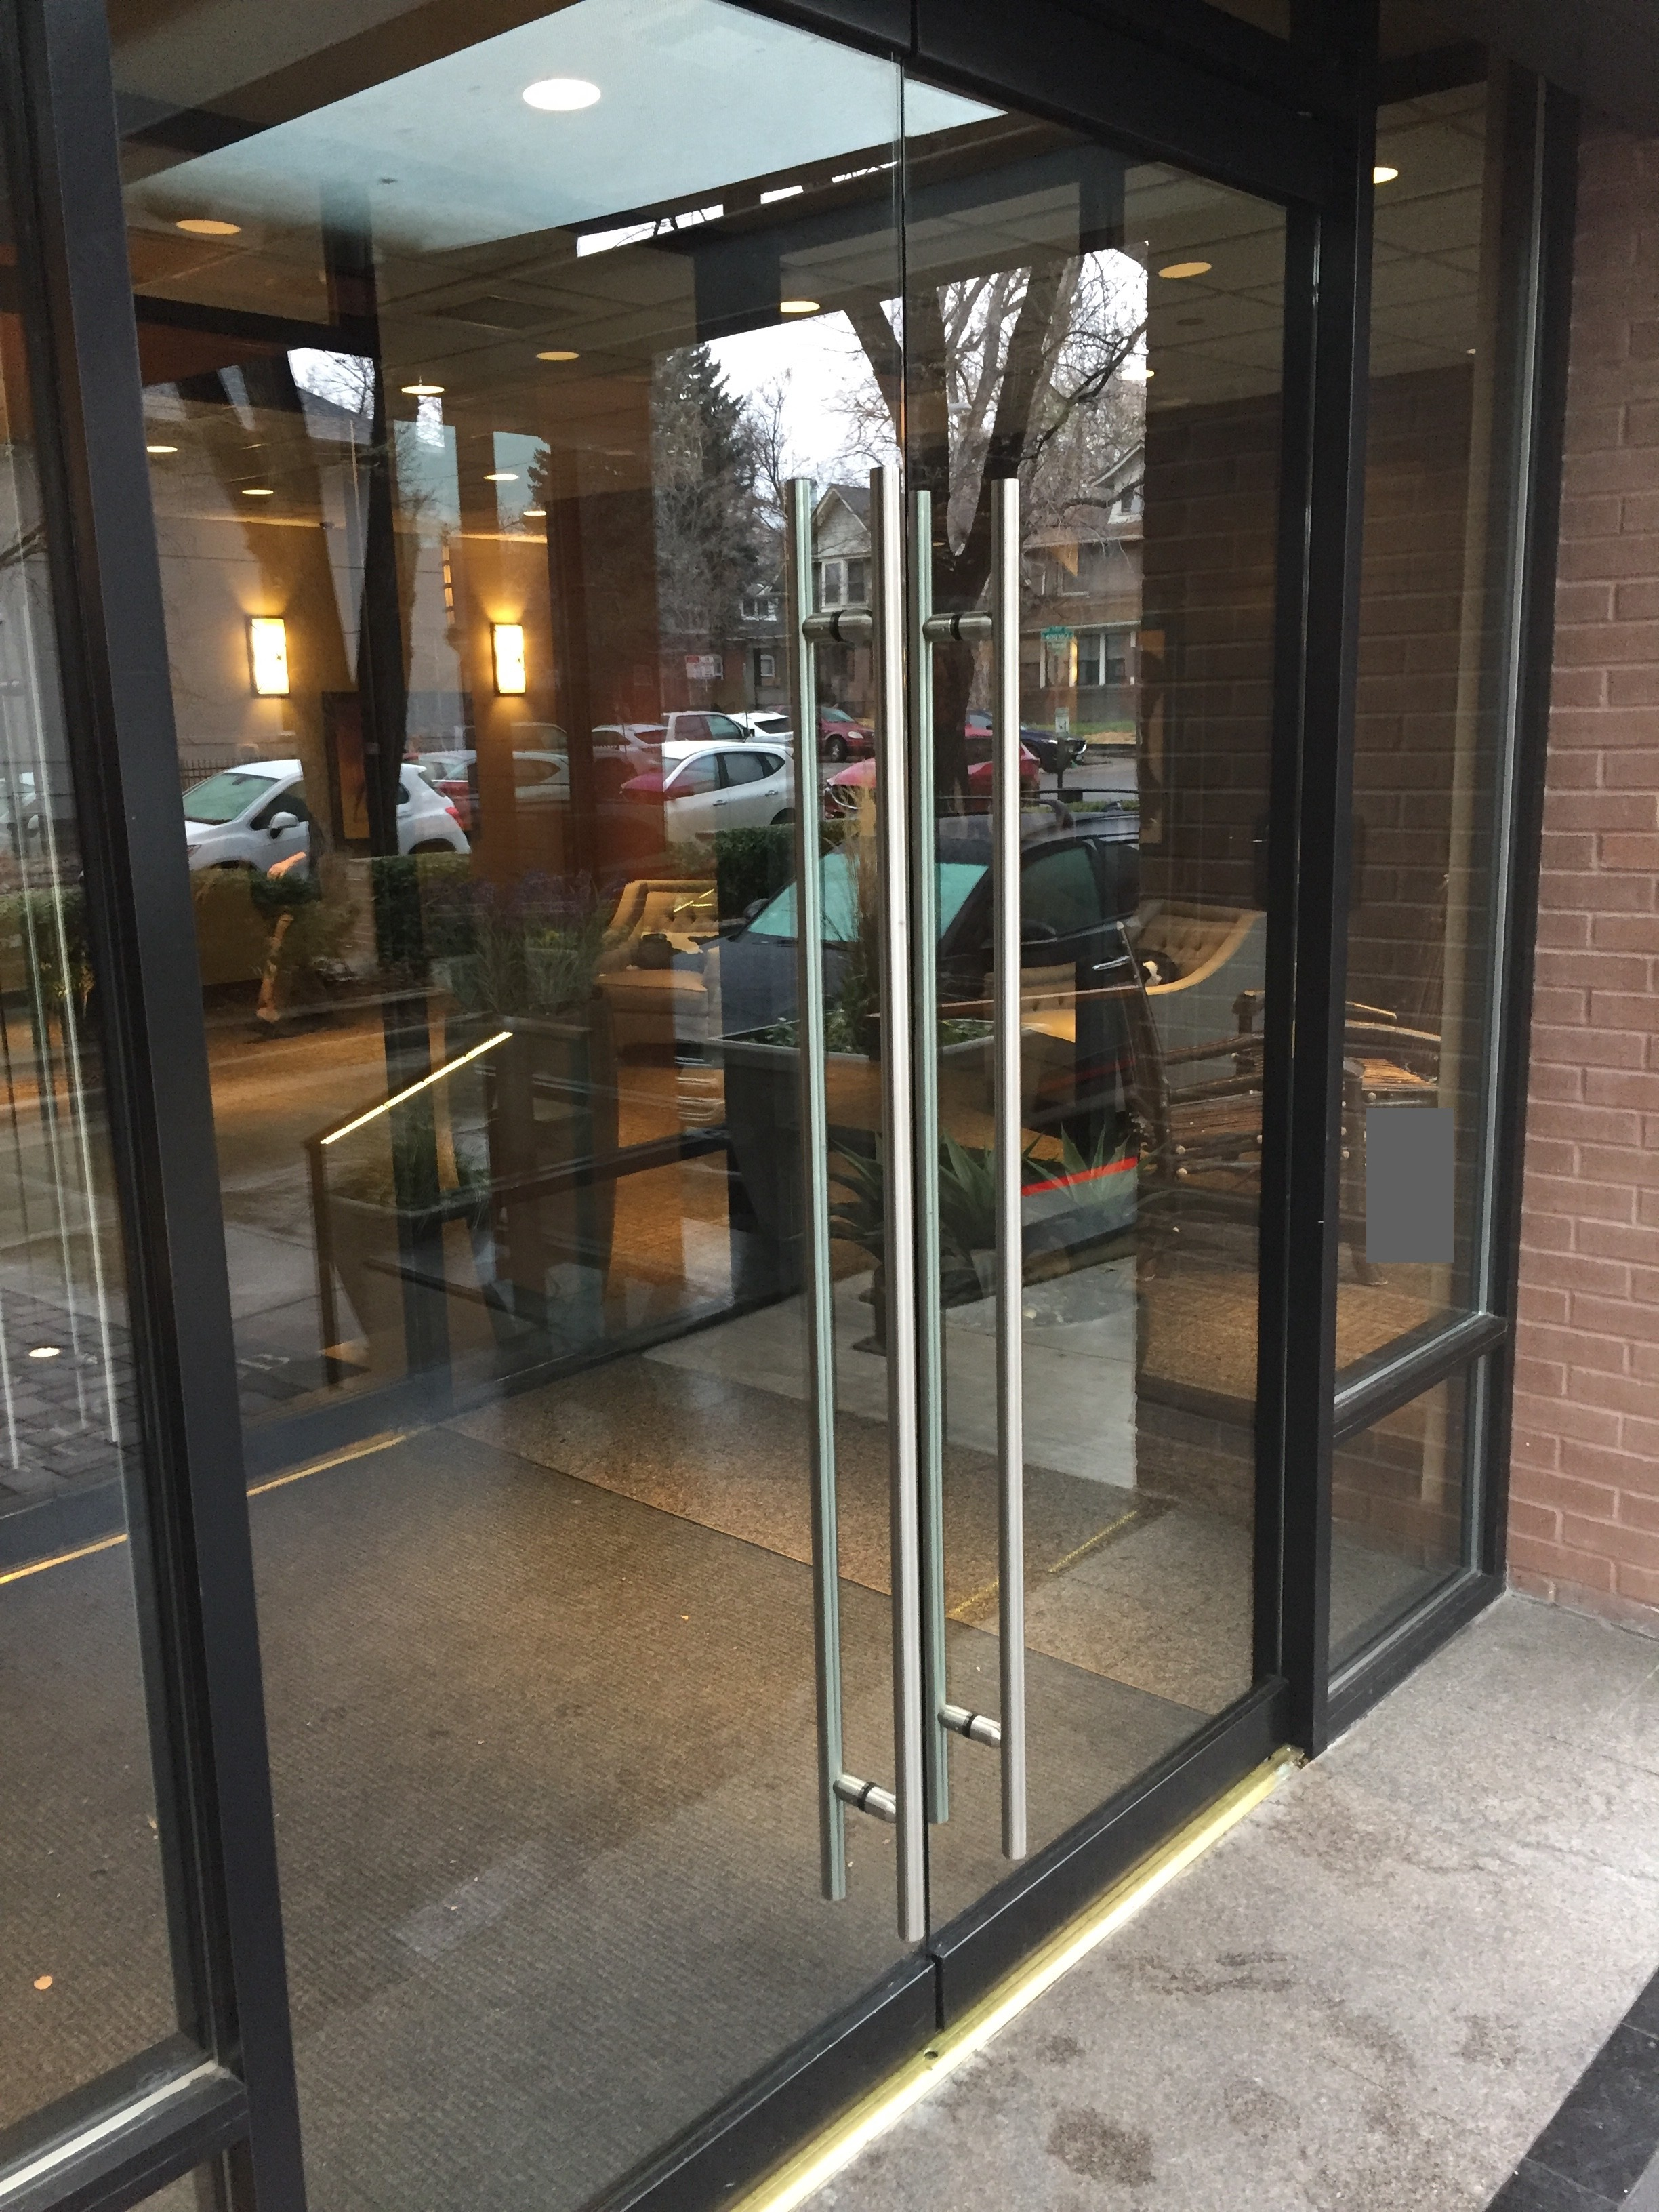
Usable or Unusable?
Notes:
Let's look at what usability means and why it is important. Here is an example of two door handles.... both are not really usable because you can't figure immediately out whether to pull or push

Slide 6
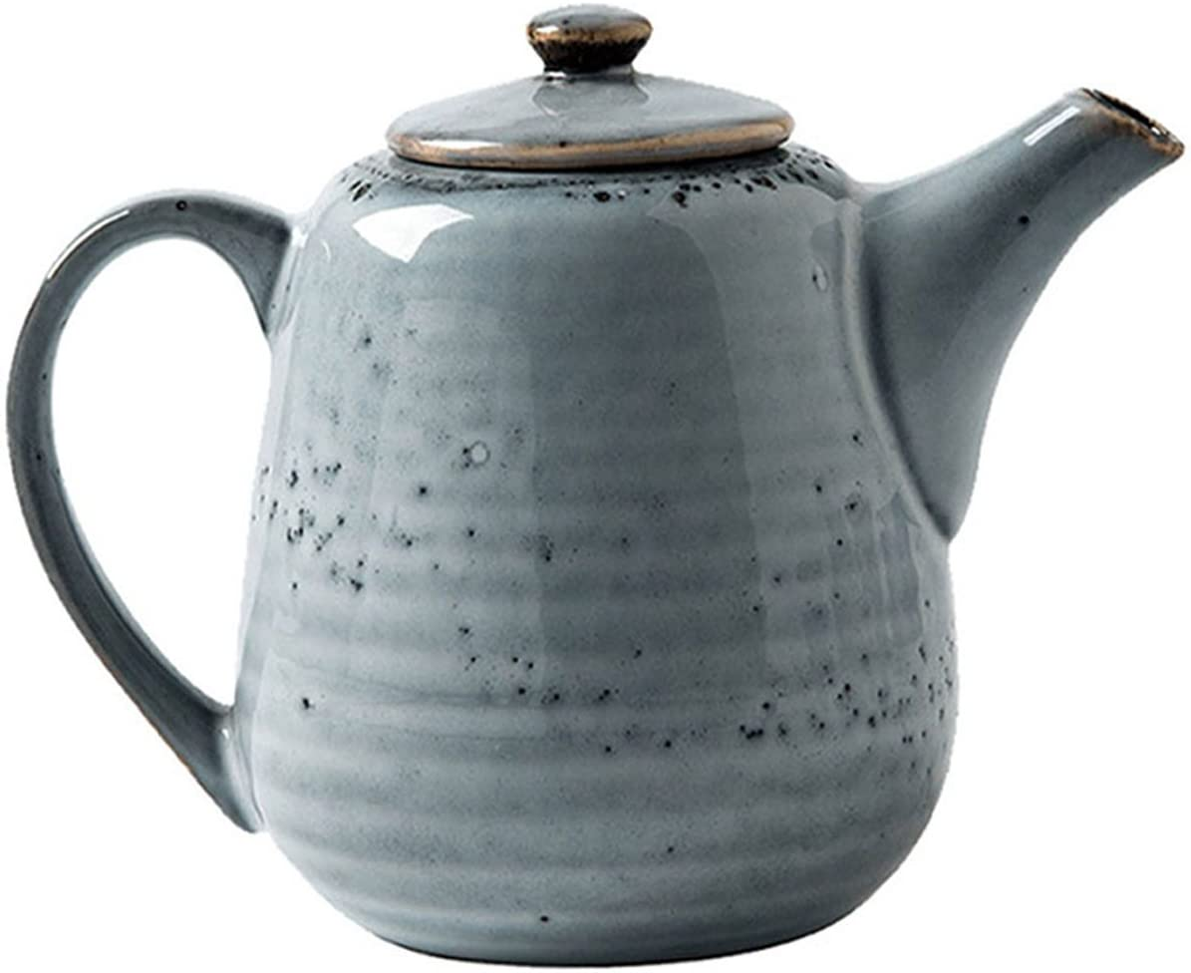
Usable or Unusable?
From Don Norman, Psychology of Everyday Things (c 1988)
Notes:
Here is a tea pot that has handle, lid, handle and spout that we can use to make and pour tea. The one on the right has all the characteristics of tea pots but its not usable.

Slide 7
“Usability”: a Definition
Usability is …
… a measure of how …
… an artifact …
... impacts …
… a human …
… with particular goals.
For us:
a software artifact
The goals are key!
7
Notes:
Let’s formally present the definition of usability:
<read slide>

Slide 8

Usability Characteristics (1 of 5): Learnability
How easy is it to learn to use the artifact to accomplish a goal?
A “steep” learning curve requires a lot of expertise before one can achieve results.
Expertise
Result
Notes:
We will look at five aspects of useability, the first one is learnability, how easy it is. To use the artifact to accomplish some goal. If we have a steep learning curve, that means we need a lot of expertise before we're able to achieve results, a more gentle learning curve allows someone to make results even with a small amount of expertise.
You can probably think of few scenarios where a steep learning curve might not work for some group of users.

Slide 9

Usability Characteristics (2 of 5): Effectiveness
How often does the use lead to completion of a goal?
Is the artifact “fit for purpose”?
Notes:
Effectiveness. How often does he use lead to completion of a goal, is the artifact fit for purpose, or is it like trying to fit a square peg into a round hole?

Slide 10
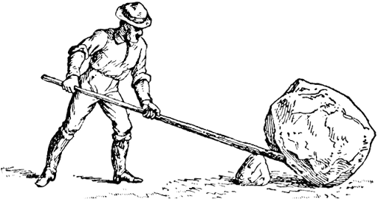
Usability Characteristics (3 of 5): Productivity
How large a multiplier of human effort does this artifact give?
Does it make hard things easy? (or the reverse!)
Notes:
The third aspect is productivity, how large a multiplier of human effort does this artifact give? Does it make hard things easy? Or one hopes it doesn't do the reverse.

Slide 11
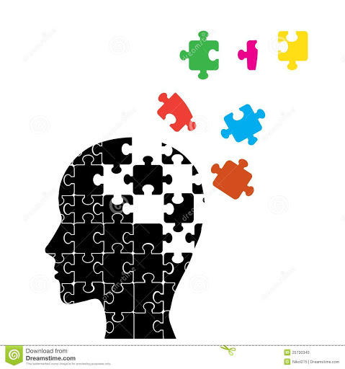
Usability Characteristics (4 of 5): Retainability
How long is the ability to use the artifact retained between uses?
Inner consistency can help mitigate a steep learning curve.
Notes:
The fourth aspect is retain-ability, how long is the ability to use artifact retained between uses? Inner consistency can help mitigate a steep learning curve. So at least with a steep learning curve, one hopes that the ability to use it will be retained.

Slide 12
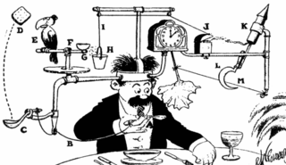
Usability Characteristics (5 of 5): Satisfiability
How pleasant is the artifact to use?
Is it elegant and simple?
Notes:
And fifth, satisfied, how pleasant is the artifact to use, is it elegant and simple? Would you use this contraption to wipe your mustache to get the soup of. I doubt it.
These characteristics remind me of Mitch Kapor, the creator of Lotus 1-2-3, presented a “software design manifesto” in Dr. Dobbs Journal. He said: Good software design should exhibit:
Firmness: A program should not have any bugs that inhibit its function.
Commodity: A program should be suitable for the purposes for which it was intended.
Delight: The experience of using the program should be pleasurable one.

Slide 13
Why study Usability?
It is crucial for user satisfaction
Adapted from Maneesh Agrawala & Bjoern Hartmann
Crash of AA Flight 965
Airbus A350 Cupholders
http://en.wikipedia.org/wiki/American_Airlines_Flight_965
Notes:
Studying usability is important because it has direct impact on product acceptance and user satisfaction. Here are three examples: A random generated password which can't be copied and is confusing & difficult. AA Flight 965 Crash due to autocomplete feature and Airbus A350 not having large enough cup holders that pilots can put coffee cups on. Some of these decisions may end up saving lives. Prof. Wand says that a friend of his, a prominent Computer Science Professor from Brown University, was on Flight 965.

Slide 14
“Usability
Not…
“dummy proofing”
being “user-friendly”
making software pretty
Usability IS:
Recognize: “The user may not be like me”
Understanding user needs, tasks, goals
User’s mental model matches with designer’s mental model
14
Notes:
Remember that usability is not just making your product dummy proof, or user friendly or making it pretty. It is about reconizing the needs or the user, and the tasks that need to be completed or goals that have to be met. These user needs might be different than that developer thinks. We want to make sure that the user mental model (which is how user thinks system should look like or work) is as close to developer mental model as possible.

Slide 15
User-Centered Design
A system is evaluated from the user viewpoint.
Ideally by the users!
Tension: when do we evaluate?
An incomplete product may not be usable;
If a product is complete, using evaluation has cost.
Resolution: evaluate prototype!
Evaluate
Requirements
Develop
Prototype
Notes:
To do that, we use User-centered design. It's where we evaluate a system from the user's viewpoint. Ideally by the users. And there's a tension here, when do we evaluate if we have an incomplete product? It may not be usable. On the other hand, if the product is complete and we do a user evaluation and determine, we need to make changes that can be very expensive. The way to resolve this tension is to evaluate a prototype. So evaluation gets requirements, we use those to guide development that gets a prototype and then that can be evaluated and we repeat the cycle.

Slide 16
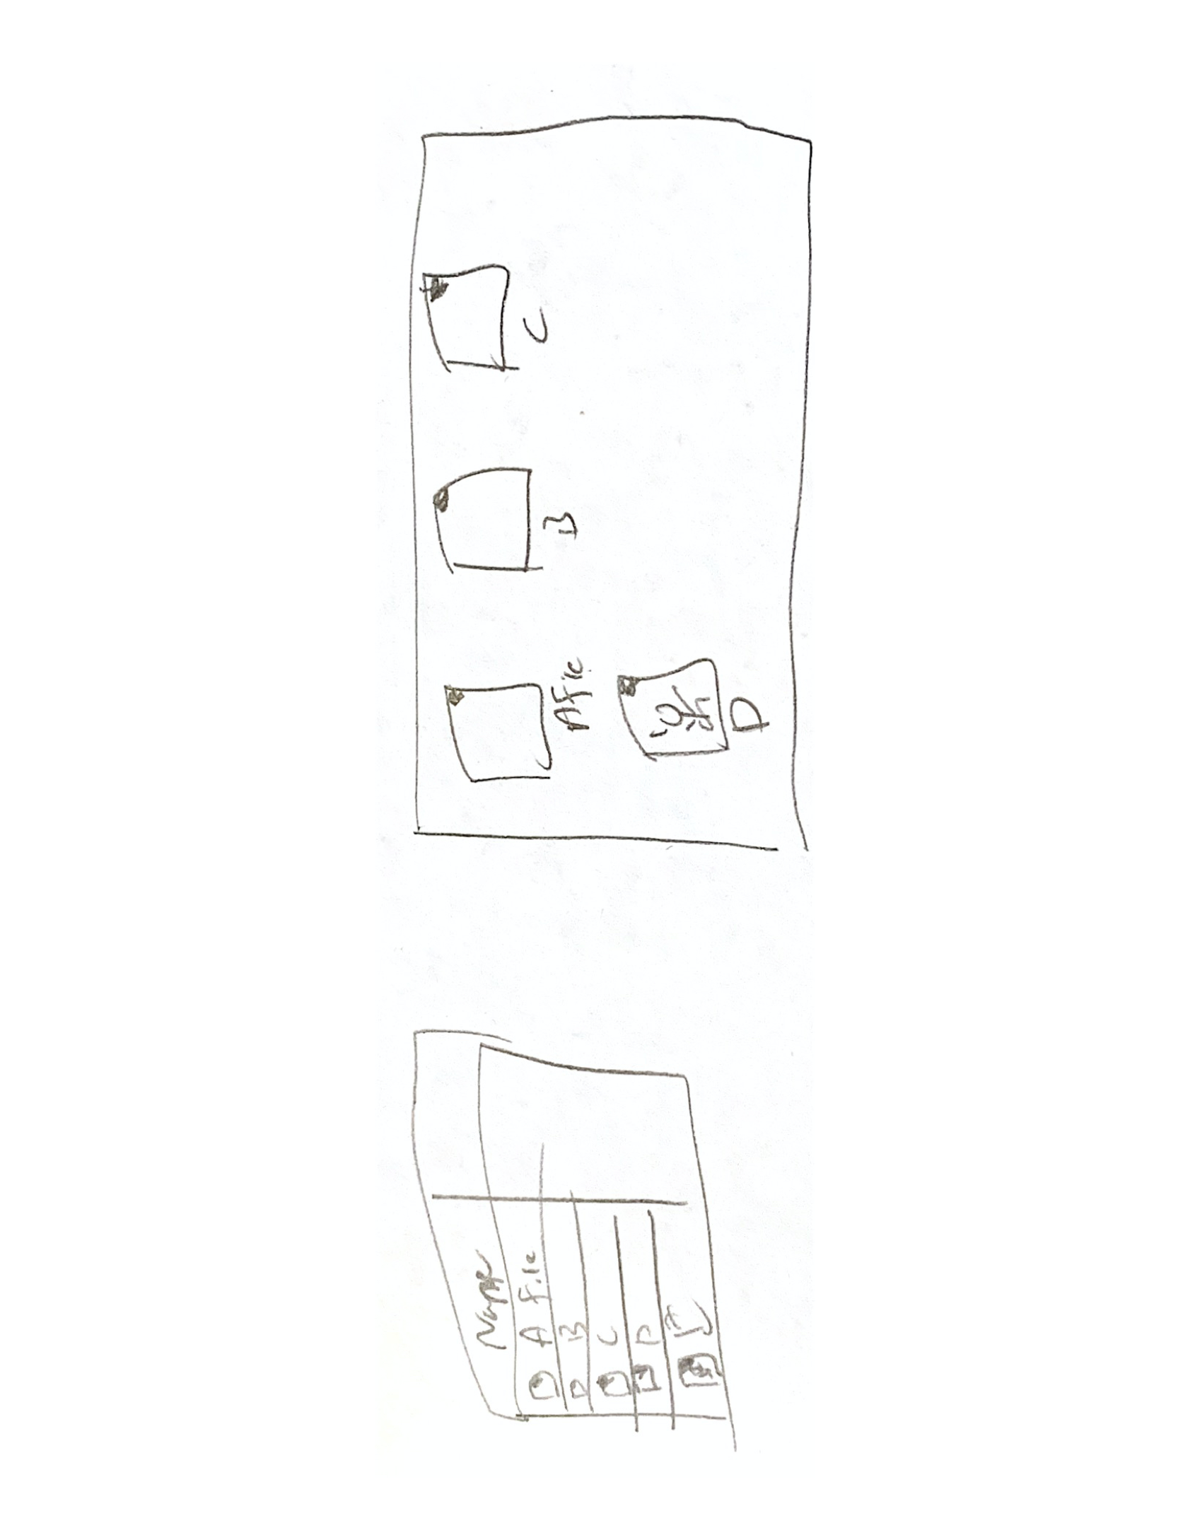
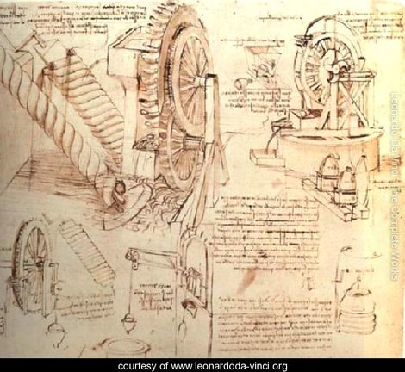
Key Idea: Design Alternatives
Use sketches
Notes:
The key idea at this stage is to look for design alternatives. One way we do this is by using sketches. We make a lot of sketches to show different ways the system could look like or could work. May be use a listview or cardview. You always have to look broadly from different perspectives. Here is another example where we see different views that are used to display files in your computer....

Slide 17
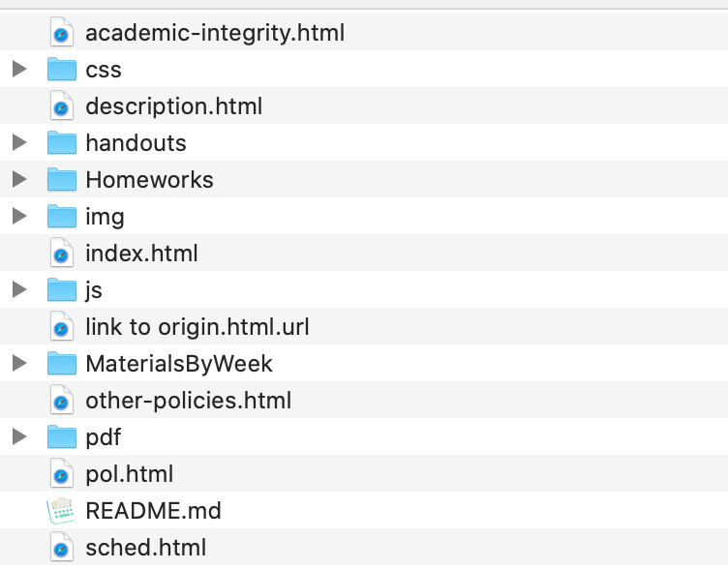
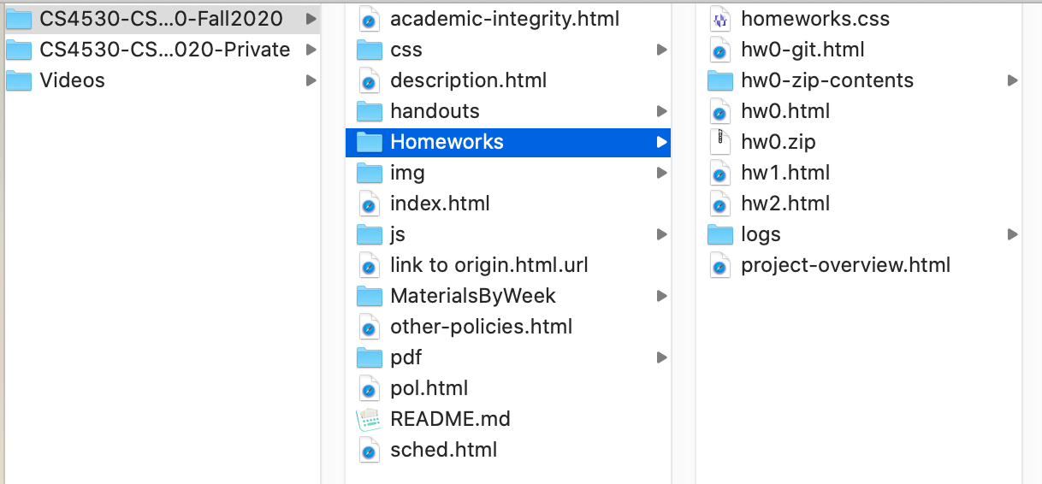
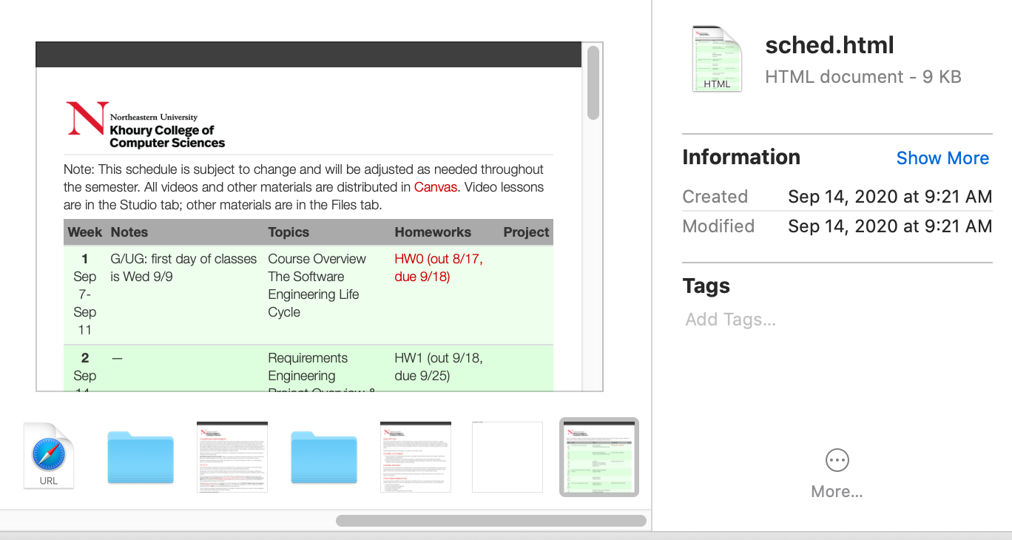
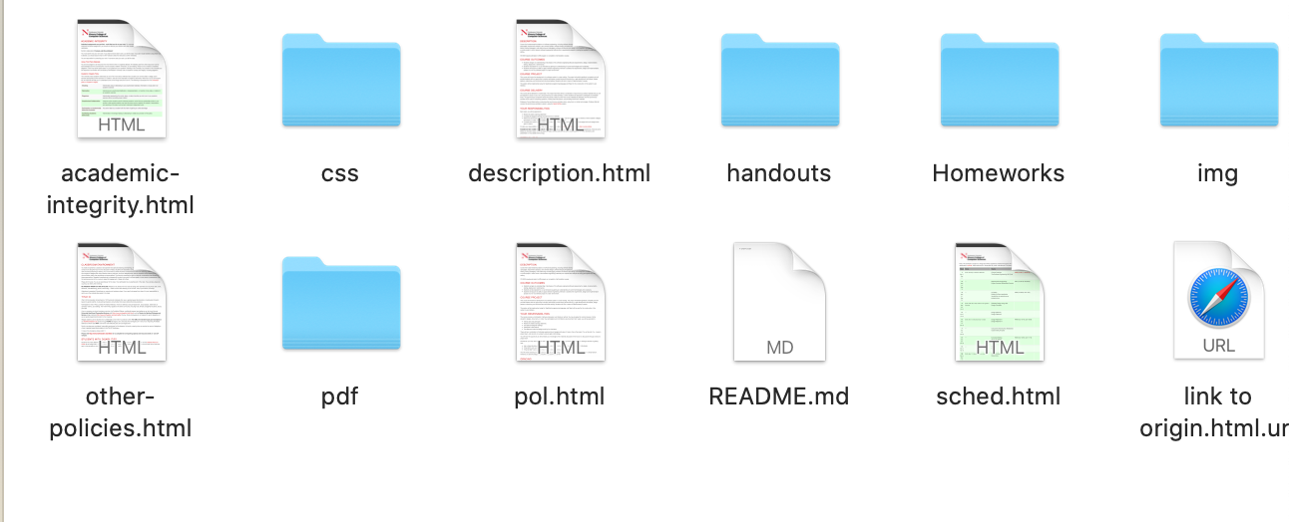
Key Idea: Design Alternatives
Think broadly with wide range of possible designs then choose “one”
Notes:
At this stage we often practice Diversification and then Convergence: Diversification is the acquisition of repertoire of alternatives: components, component solutions, knowledge contained in catalogues, books, and mind Convergence is choosing the best one to meet requirements
They combine intuition, judgement with experience and help to build components, evolve models, measure quality then iterate to final design!

Slide 18
Prototype (1 of 3): Paper Simulation
Hand-drawn user interfaces:
on paper or card;
made on the spot.
Developers animate:
Present to test user;
Users act:
Indicate what they would do.
Advantage: fast turnaround, cost less, allow more iterations
Notes:
We will now look at three different kinds of prototypes. The first kind of prototype is a paper simulation. We use hand drawn user interfaces on paper or cards, and they may even be made on the spot while interacting with the user. The developers animate these physical objects and present them to a test user. And the user says what they would do, what buttons they would press, etc. And then the developers say, OK, now let's say this shows up.
This is obviously very cheap in physical resources.

Slide 19
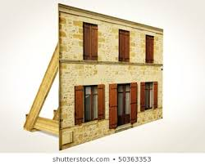
Prototype (2 of 3): Wizard-of-Oz
Software has right “look”
But barely functional.
Scripted interaction only
All responses are “canned.”
Illusion is effective.
Notes:
The next level is a Wizard of Oz prototype. This is where software has the right look, but it's barely functional. It only handles scripted interaction, they may have oodles of wit of menus and options, but actually only a few of them will actually work at all. And all the responses are canned. However, the illusion can be very effective. It gives a real sense of how it is to use the product, even if you know, the only thing you can do now is insert in italicized paragraph.

Slide 20
Prototype (3 of 3): Working Prototype
The software system partly implemented:
User interface fully realized;
Functionality limited.
Particularly for feature requests:
New feature can get quick-and-dirty implementation
Quickly get feedback if the right feature is implemented.
Comparison of UCD with TDD:
In TDD: feature request is realized in a test;
In UCD: feature request is realized in a user-interface.
In both cases, we delay implementation
until more understanding gained:
Move decisions closer to customers.
Notes:
The third level is a working product. This is where the software system is partly implemented, the user interface is fully realized, but the functionality is limited. This is particularly useful for feature requests, a new feature can get a quick and dirty implementation and then we can quickly get feedback if the right feature is implemented. Sometimes this is called “User-Centered Design” (UCD).

Slide 21
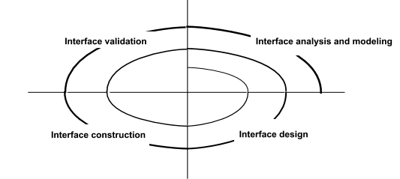
User-Centered Design is refined
Are requirements fully understood ?
Notes:
I would like to compare user centered design with test driven development. And test driven development, a feature request is realized in a test with user centered design, a feature request is realized in a user interface and our prototype. In both cases, we are delaying implementation of the guts of the feature request until more understanding is gained. We moved his decisions closer to the customers.

Slide 22
Tips for Aesthetic Design (UI Design)
Don’t be afraid of white space.
Emphasize content that meets user needs.
Organize layout elements from top-left to bottom right.
Group navigation, content, and function geographically within the page/screen.
Don’t extend your real estate with the scrolling bar.
Consider resolution and browser window size when designing layout.
https://blog.prototypr.io/ux-design-101-prototyping-rapidly-sketching-wireframes-65b7dfbabf52
Notes:
When you are working on UI design, here are few tips
<read slide>

Slide 23
Forms of User Evaluation
Empirical evaluation study
“How many tasks accomplished in N minutes?”
Qualitative evaluation
Observers find patterns in interaction;
Users give feedback after use.
”Dogfooding” (internal evaluation)
Developers use product as soon as feasible.
Heuristic evaluation
Evaluate against best practices.
Notes:
Now, how can user evaluation happen? There's empirical evaluation, so, for example, we have a product and we see how many tasks can be used to accomplish in minutes. There's a qualitative evaluation. Where observers will observe the user interacting with software and find patterns and try to see what is happening and the users can get feedback after use. Another form of user evaluation is dogfooding, which is internal evaluation, where the developers use the product that they are developing as soon as it's feasible to do so. And then there's heuristic evaluation where we evaluate the product against best practices, that's what we will be talking about next.

Slide 24
Best Practice Heuristics (Nielsen)
“Discount ($) usability engineering methods”
Pioneered by Jakob Nielsen in the 1990s
Involves a small team of evaluators to evaluate an interface based on recognized usability principles
Heuristics–”rules of thumb”
Much cheaper than an
evaluation With ”real” users!
(Adapted from slides by Bonnie John and Jennifer Mankoff)
Notes:
Now. The idea of heuristics is that there are best practices for user interfaces and this is a discount usability engineering method discount as in this is cheap and involves a small team of evaluators to evaluate an interface based on recognized usability principles. These are heuristics. This is usually much cheaper than trying to round up some real users to evaluate one software.

Slide 25
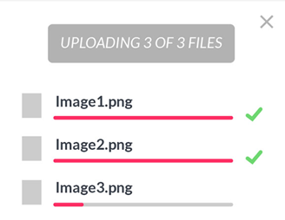
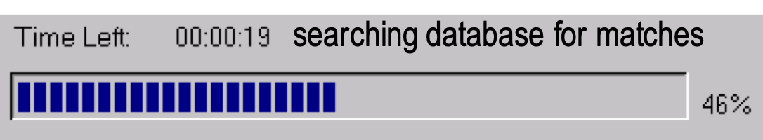
H1: Visibility of System Status
Interface should show:
What input has been received;
What processing is currently happening;
What results have already been completed.
This feedback allows
user to monitor progress towards solution of their task;
allows the closure of tasks; and
reduces user anxiety (Lavery et al).
Great podcast with interview with Brad Myers, creator/popularizer of progress bar in his 1985 PhD thesis (99 Percent Invisible 9/3/19)
Notes:
We will now look at a number of them. I believe the first one is, is there a visibility of system status? What input has been received as interface, say, with the search input was? What processing is a currently doing? Does it say what it's currently doing? What are the results of the processing? Feedback here allows the user to monitor progress towards a solution, their task and allows closure of tasks and reduces user anxiety has been shown by Lavery et al. And there's a podcast interview with Brad Myers, the person who created and popularized the progress report back in the 80s. The link is available here.

Slide 26
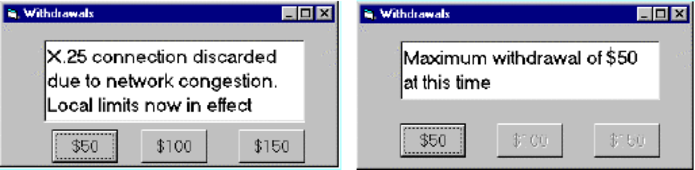
H2: Match Between System and Real World
Speak the users’ language.
Follow real world conventions.
Don’t use internal jargon (“X.25 connection discarded”)
“Gray out” illegal options.
Notes:
<read slide>

Slide 27
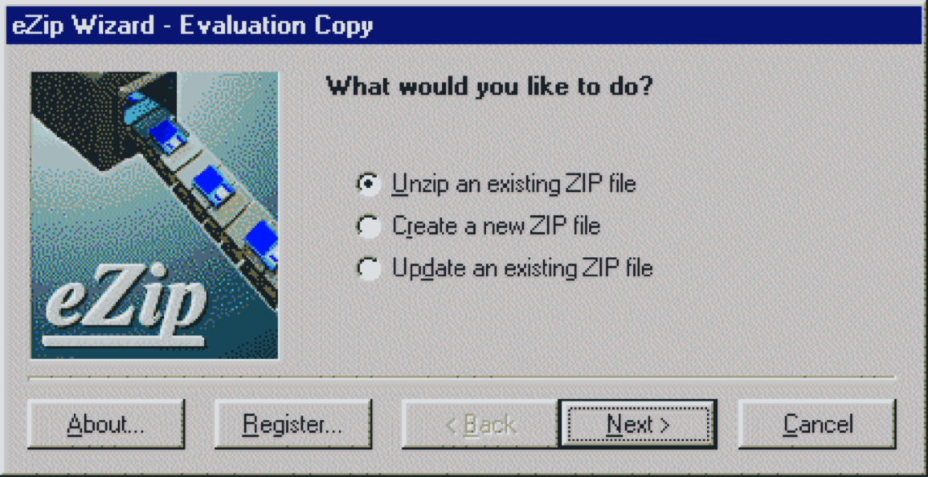
H3: User Control and Freedom
“Exits” for mistaken choices: undo, redo, cancel
Don’t force down fixed paths.
Notes:
The 3rd characteristic is do we provide user control and freedom? Is there a way of turning back if we've done a mistaken choice to have undo, redo or cancel? The idea is you don't want to just force the user down a particular path that will be very unpleasant.

Slide 28
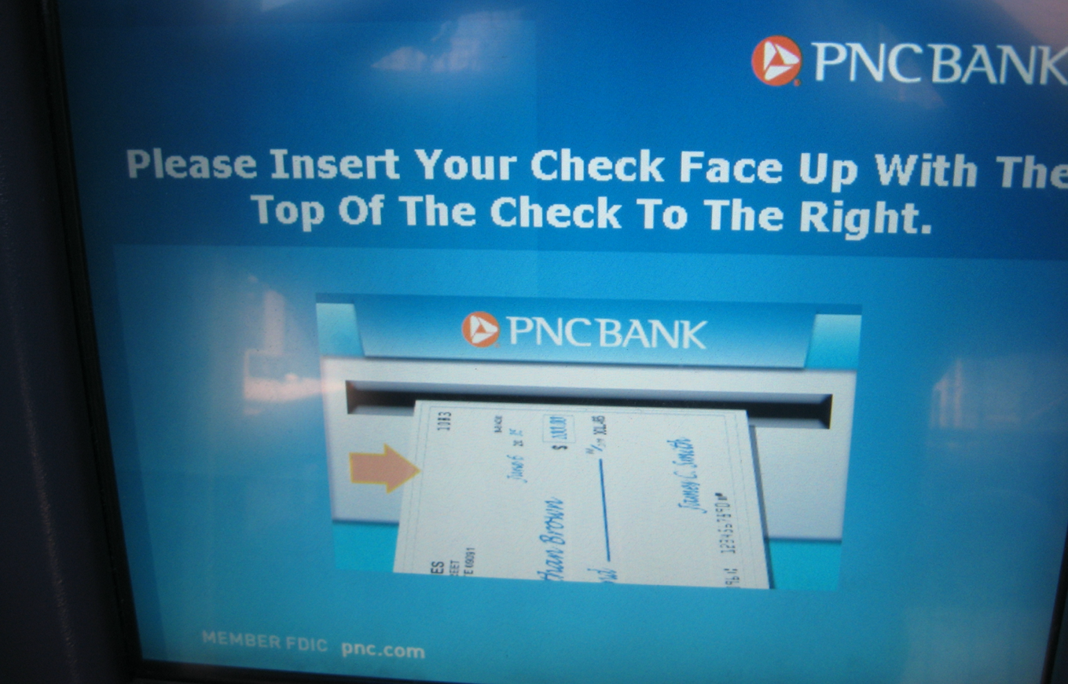
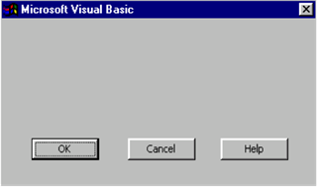
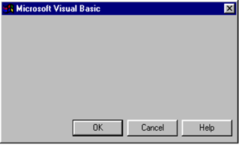
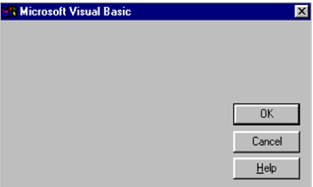
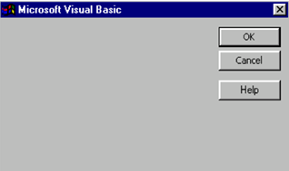
H4: Consistency and Standards
Same words, situations, actions, should mean the same thing in similar situations;
Same things look the same and be located in the same place.
Text consistent with figures.
Different things should be different.
Notes:
The fourth Heuristic our consistency and standards, the same word situations and action should mean the same thing in similar situations, the same things should look the same and be located in the same place. And the text should be consistent with the figures. If you look at the figure there. You'll notice there's an inconsistency. On the other hand, different things should be shown differently.

Slide 29
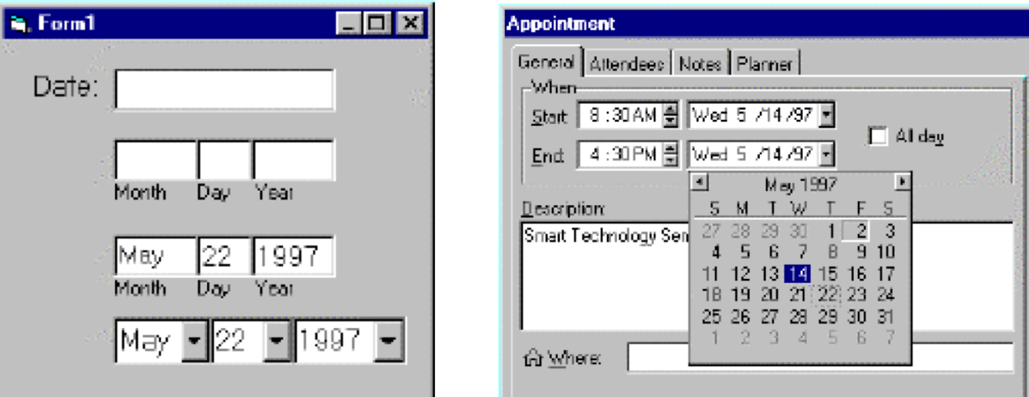
H5: Error Prevention
Careful design can prevent a problem from occurring in the first place.
It’s easier to point to a date on the calendar than to type it in the correct format.
Notes:
The fifth heuristic is error prevention. Careful, designed to prevent a problem from occurring in the first place. It's really quite tricky to type in a date into the format that's been expected and people need a lot of guidance. It's much easier to have them point to a date on a calendar.

Slide 30
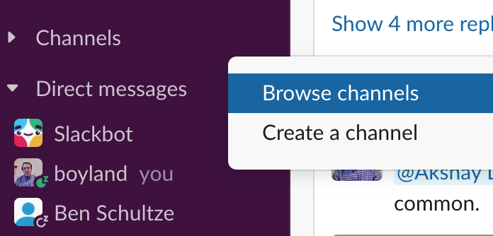
H6: Recognition rather than Recall
Make objects, actions and options visible or easily retrievable.
It’s easier to pick out the channel we want to add than to enter the correct name.
Notes:
The six principles, recognition, it's easier than we call make objects, actions and options visible or easily retrievable, for example, but slack, if you want to add a channel, it's easier to pick out the channel from the list than to have to enter in the correct name.

Slide 31
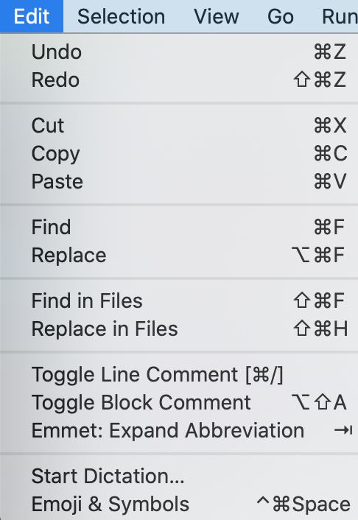
H7: Flexibility and Efficiency of Use
Accelerators for experts (e.g., gestures, kb shortcuts)
Allow users to tailor frequent actions (e.g., macros)
Notes:
The next principles is flexibility and efficiency of use. For example, provide accelerator's for experts. This allows them to be more productive and allow users to tailor frequent actions, for example, that provide the ability to define macro's.

Slide 32
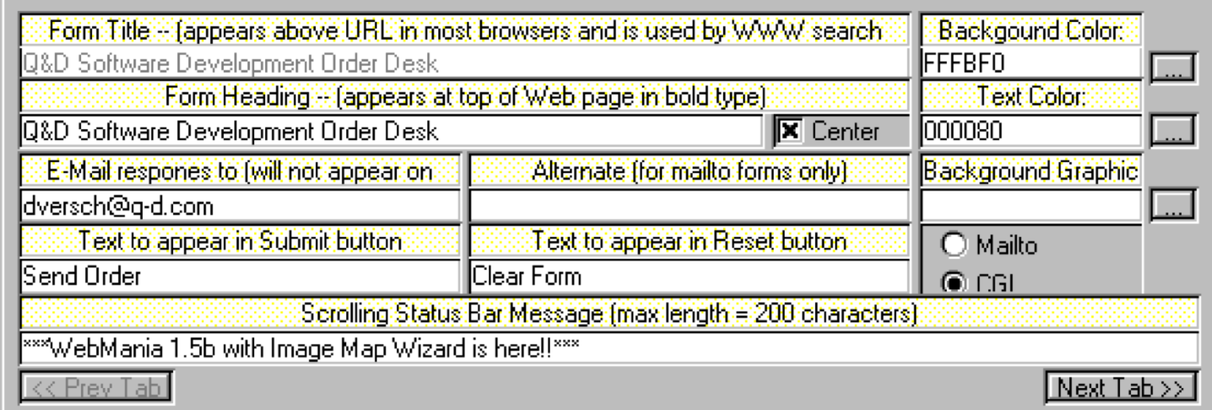
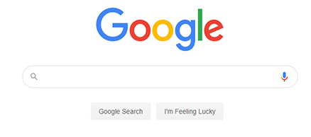
H8: Aesthetic and Minimalist Design
Interfaces should not contain irrelevant or rarely needed information.
Here is an example of minimalist design:
Notes:
An eighth principle is aesthetic and minimalist design interfaces should not contain irrelevant or rarely needed information. We have an example back here from the early 90s, appears of a tax form of far too many options.
If you want an example of minimalistic design, look no further than google

Slide 33
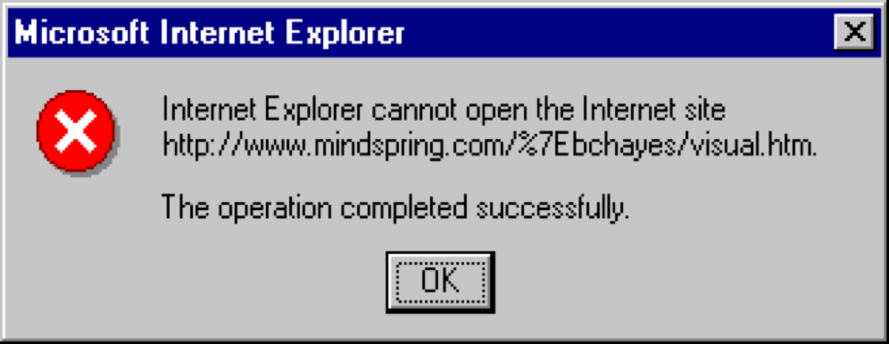
H9: Help users recognize, diagnose, and recover from errors
Use standards to convey errors;
Error messages should be in language user will understand;
Precisely indicate the problem;
Constructively suggest a solution.
Notes:
The ninth principals help users recognize, diagnose and recover from errors. Use standards to convey errors. Error messages should be in a language that users will understand and precisely indicate the problem constructively suggests a solution. The error here is incomprehensible because it claims that the operation is completed successfully when apparently there was an error.

Slide 34
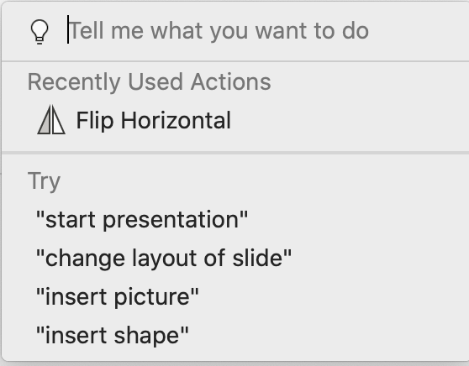
H10: Help and Documentation
Should be
Easy to search;
Focused on the user’s task;
List concrete steps to carry out;
Always available.
Notes:
And the tenth principle is help and documentation provide help and documentation while the program is running. Don't force people to buy the book. It help that conditions be easy to search, focused on the user's task, it's a list, concrete steps to carry out, and he always available.

Slide 35
Review: Learning Objectives for this Lesson
you should now be able to:
Describe the major aspects of usability;
Articulate the process of user-centered design;
Explain several heuristics for good user interaction.
Notes:
Before we finish, let’s discuss: What do you think are common mistakes in UI Design?
Featuristis: Practice of trading functional coverage for and/or over system quality – quantity over quality
Flexibilitis: overly flexible systems (with too many adaptations and configuration facilities) – flexibility is a cover for uncertainty
Performitis: performance over quality (ignoring maintainability, reliability or security) – over emphasizing performance.
<read slide>

